Slide 1

Chapter 3
APPLICATIONS OF DERIVATIVES

Slide 2
Contents
3.1. Maximum and minimum
3.2. Mean value theorem
3.3. Derivates and the shapes of Graphs
3.5. Optimization Problems
3.6. Newton’s Method
3.7. Antiderivatives

Slide 3
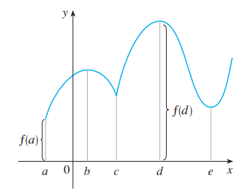
3.1. Maximum and minimum values
Definition 1
A function f has an absolute maximum (or global
maximum) at c if f(c) ≥ f(x) for all x in D, where D
is the domain of f.
The number f(c) is called
the maximum value of f
on D.

Slide 4

3.1. Maximum and minimum values
Definition 1
Similarly, A function f has an absolute minimum
(or global minimum) at c if f(c) f(x) for all x in
D, where D is the domain of f.
The number f(c) is called
the minimum value of f
on D.
The maximum and minimum
values of f are called
the extreme values of f.

Slide 5
3.1. Maximum and minimum values
Definition 2
  A function f has a local maximum (or relative maximum) at c if f(c) ≥ f(x) when x is near c.
  Similarly, f has a local
  minimum at c if
  f(c) ≤ f(x) when x is near c.

Slide 6
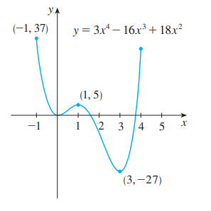
3.1. Maximum and minimum values
Example 1:
The graph of the function f(x) = 3x⁴ – 16x³ + 18x², -1 ≤ x ≤ 4
is shown here.
f(-1) = 37 is the absolute maximum
f(0) = 0 is a local minimum
f(1) = 5 is a local maximum
f(3) = -27 is both a local and an
absolute minimum.

Slide 7
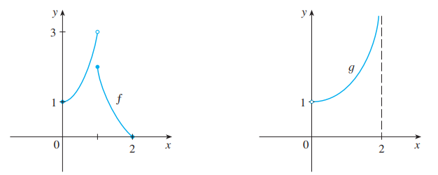
3.1. Maximum and minimum values
Example 2:
In the first figure, why isn’t 3 the absolute maximum value ?
In the second, does it have the absolute maximum and minimum value ?

Slide 8
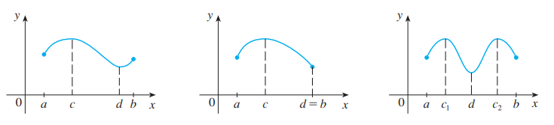
3.1. Maximum and minimum values
Theorem
If f is continuous on a closed interval [a, b], then f attains an absolute maximum value f(c) and an absolute minimum value f(d) at some numbers c and d in [a, b].

Slide 9
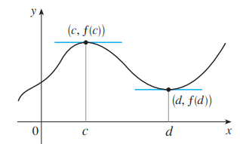
3.1. Maximum and minimum values
Extreme value theorem
The theorem does not tell us how to find these extreme values.
  We start by looking for local extreme values.

Slide 10
Fermat’s theorem
3.1. Maximum and minimum values
Theorem
If f has a local maximum or minimum at c, and if f ’(c)
exists, then f ’(c) = 0.

Slide 11
3.1. Maximum and minimum values
Is it true if say that
” f’(c)=0 if f has local extreme value at c ?”
Answer: It is false, see next.

Slide 12
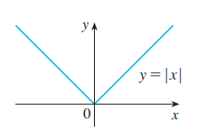
Critical numbers
3.1. Maximum and minimum values
Example
  The function f (x) = |x| has its (local and absolute) minimum value at 0.
  f ’(0) does not exist.

Slide 13
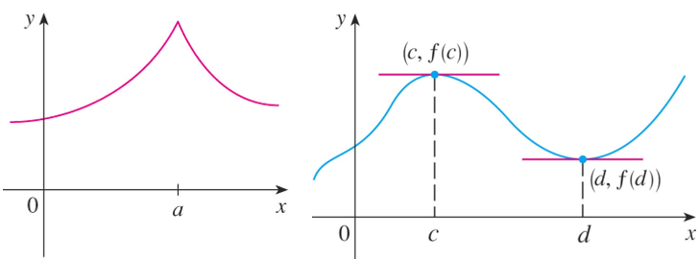
3.1. Maximum and minimum values
Critical numbers
Definition
A critical number (giá trị tới hạn) of a function f is a number c in the domain of f such that either f ’(c) = 0 or f ’(c) does not exist.

Slide 14
3.1. Maximum and minimum values
Critical numbers
Theorem
If f has a local maximum or minimum at c,
then c is a critical number of f.

Slide 15
Closed interval method
3.1. Maximum and minimum values
To find the absolute maximum and minimum values of a continuous function f on a closed interval [a, b]:
1/ Find the values of f at the critical numbers of f
in (a, b).
2/ Find the values of f at the endpoints of the interval.
3/ The largest value from 1 and 2 is the absolute maximum value. The smallest is the absolute minimum value.
Notes:
Example: find absolute extreme for the function f(x) = (x-2)/ (x² +1) on the interval.

Slide 16
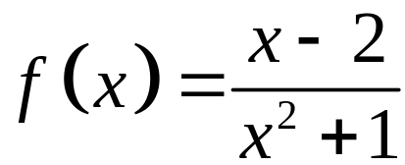
Closed interval method
3.1. Maximum and minimum values
Example:
Find absolute extreme for the function
on the interval.
Notes:
Example: find absolute extreme for the function f(x) = (x-2)/ (x² +1) on the interval.

Slide 17
3.1. Maximum and minimum values
Quize question
Select the correct ones.
If f’(c)=0 then f has the local maximum or minimum at c.
If f has the absolute minimum value at c then f’(c)=0.
If f is continuous on (a,b) then f attains an absolute maximum value
f(c) and an absolute minimum value f(d) for some c and d in (a,b).
d. All of the above.
e. None of the above.
Notes:
Answer: e

Slide 18
Rolle’s theorem
3.2.The Mean Value Theorem
Let f be a function that satisfies the following three hypotheses:
1/ f is continuous on the closed interval [a, b]
2/ f is differentiable on the open interval (a, b)
3/ f(a) = f(b)
Then, there is a number c in (a, b) such that
f’(c) = 0.

Slide 19
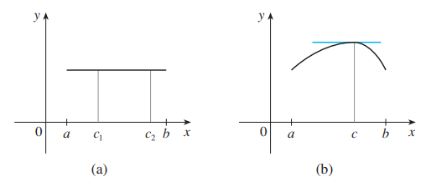
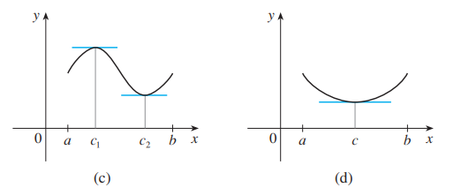
3.2.The Mean Value Theorem
Rolle’s theorem
The figures show
the graphs of
four such functions.

Slide 20

3.2.The Mean Value Theorem
Example:
Let . Find the numbers c in
the Rolle’s theorem ?

Slide 21
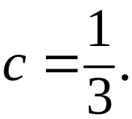
3.2.The Mean Value Theorem
Example:
Let . Find the numbers c in the
Rolle’s theorem ?
Solution:
1/ f is continuous on the closed interval [0, 1]
2/ f is differentiable on the open interval (0, 1)
3/ f(0) = f(1)= - 5.
Then
So,

Slide 22
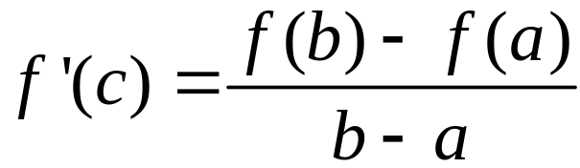
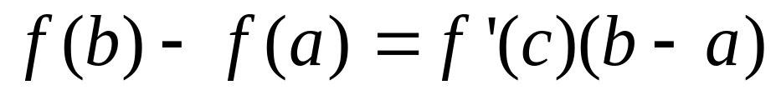
3.2.The Mean Value Theorem
Mean value theorem
Let f be a function that fulfills two hypotheses:
  a/ f is continuous on the closed interval [a, b].
  b/ f is differentiable on the open interval (a, b).
Then, there is a number c in (a, b) such that
or, equivalently,

Slide 23
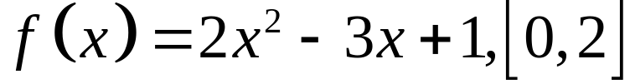
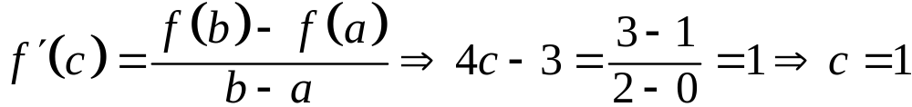
3.2.The Mean Value Theorem
Mean value theorem
Example
Let .Find all numbers that
satisfy the conclusion of the Mean Value Theorem.
Solution

Slide 24
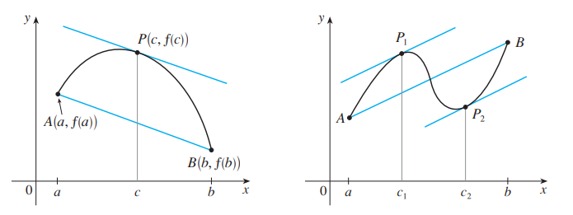
3.2.The Mean Value Theorem
Mean value theorem
f ’(c) is the slope of the tangent line at (c, f(c)).There is at least one point P(c, f(c)) on the graph where the slope of the tangent line is the same as the slope of the secant line AB.

Slide 25
3.2.The Mean Value Theorem
Mean value theorem
Example
Suppose that f(0) = -3 and f ’(x) ≤ 5 for all values of x. How large can f(2) possibly be ?
Solution
We are given that f is differentiable - and therefore continuous - everywhere.
In particular, we can apply the Mean Value Theorem on the interval [0, 2].

Slide 26
3.2.The Mean Value Theorem
  There exists a number c such that f (2) – f(0) = f ’(c)(2 – 0)
  So, f(2) = – 3 + 2 f ’(c)
  We are given that f ’(x) ≤ 5 ∀x
  ⇒ f ’(c) ≤ 5.
  ⇒ 2 f ’(c) ≤ 10.
  ⇒ f(2) = – 3 + 2 f ’(c) ≤ – 3 + 10 = 7
  The largest possible value for f(2) is 7.

Slide 27
3.2.The Mean Value Theorem
Theorem
If f ’(x) = 0 for all x in an interval (a, b), then f is constant on (a, b).
Corollary
If f ’(x) = g’(x) for all x in an interval (a, b),
then f – g is constant on (a, b).
That is, f (x) = g(x) + c where c is a constant.

Slide 28
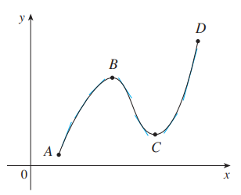
Increasing/Decreasing test (I/D test)
3.3.Derivatives and the Shapes of Graphs
a/ If f’(x) > 0 on an interval,
then f is increasing
on that interval.
b/ If f’(x) < 0 on an interval,
then f is decreasing on
that interval.

Slide 29
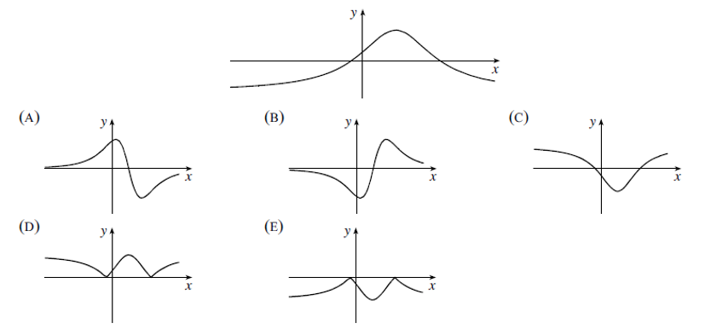
3.3.Derivatives and the Shapes of Graphs
Increasing/Decreasing test (I/D test)
Example: The graph of f is show below. Which of the
following could be the graph of f’ ?
Notes:
If f(x) > 0 every x in I, the graph of its lies above x-axis. Answer: (A)

Slide 30
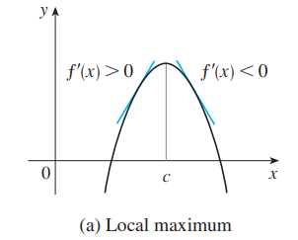
3.3.Derivatives and the Shapes of Graphs
First derivative test
Suppose that c is a critical number of a continuous function f.
a/ If f’ changes from positive to negative at c, then f has a local maximum at c.
Notes:
For example y = -x²

Slide 31
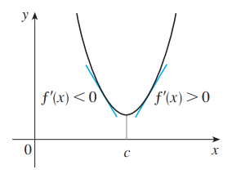
3.3.Derivatives and the Shapes of Graphs
First derivative test
Suppose that c is a critical number of a continuous function f.
b/ If f’ changes from negative to positive at c, then f has a local minimum at c.
Notes:
For example y = -x²

Slide 32
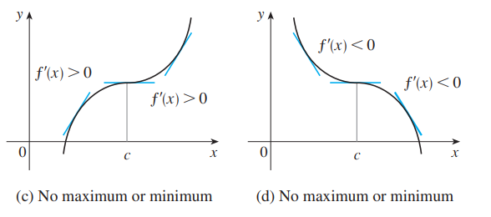
3.3.Derivatives and the Shapes of Graphs
First derivative test
Suppose that c is a critical number of a continuous function f.
c/ If f’ does not change sign at c
then f has no local maximum or minimum at c.
Notes:
For example y = -x²

Slide 33
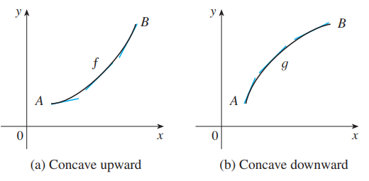
Concave upward/ downward
3.3.Derivatives and the Shapes of Graphs
  The curve lies above the tangents and f is called concave upward (lõm lên) on (a, b).
  The curve lies below the tangents and g is called concave downward (lõm xuống) on (a, b).

Slide 34
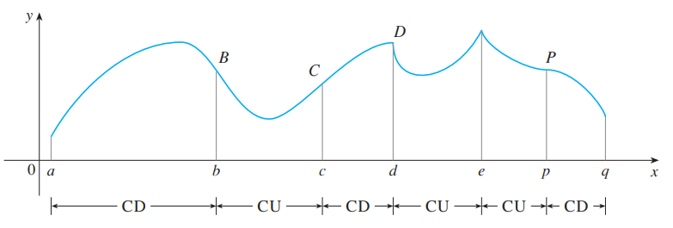
3.3.Derivatives and the Shapes of Graphs
Concavity test
a/ If f’’(x) > 0 for all x in I, then the graph of f is concave upward on I.
b/ If f’’(x) < 0 for all x in I, then the graph of f is concave downward on I.

Slide 35
3.3.Derivatives and the Shapes of Graphs
Inflection point-Definition
A point P on a curve y = f(x) is called an inflection point (điểm uốn)
if f is continuous there and the curve changes
from concave upward to concave downward
(or from concave downward to concave upward at P).
Notes:
f’’(x) =0 does not imply that (x,f(x)) is an inflection point of f.
f’’ changes from positive to negative or f’’ changes from negative to positive at a value that f’’ = 0.

Slide 36


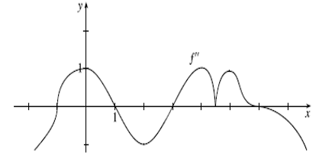
3.3.Derivatives and the Shapes of Graphs
Example
Given a grap of as below, have the students indicate the points of inflection of , and explain their reasoning.

Slide 37
3.3.Derivatives and the Shapes of Graphs
Answer:
(-1,f(-1)),(1,f(1)),(3,f(3)),(6,f(6))

Slide 38
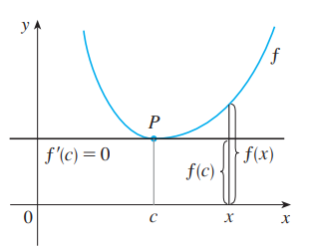
3.3.Derivatives and the Shapes of Graphs
Second derivative test.
Suppose f’’ is continuous near c.
If f’(c) = 0 and f’’(c) > 0, then f has a local minimum at c.
If f’(c) = 0 and f’’(c) < 0, then f has a local maximum at c.
Notes:
Compare the First and second derivative Tests, discussing the advantages and disadvantages of using each, including an example such as f(x) = x⁵ , where the second derivative test is inconclusive and pointing out that although f’(0) = 0,, there is no local extreme there.

Slide 39
3.3.Derivatives and the Shapes of Graphs
Example
Choose the correct one.
A | If f has local extreme value at c then f’(c)=0.
B | If f’(c)=0 then f has local extreme value at c.
C | If f’’(3)=0 then (3,f(3)) is an inflection point of f.
D | There exists a function such that f’(x) is nonzero for all x and f(1)=f(0).
E | None of the above
Notes:
Answer: e

Slide 40
3.5. Optimization Problems
Understand the problem
Read the problem carefully until it is clearly understood.
  What is the unknown?
  What are the given quantities?
  What are the given conditions?

Slide 41
3.5. Optimization Problems
Example 1:
a/ Find two positive numbers such that the sum is 24
and the product is the largest ?
b/ Find two positive numbers such that the product is 36
and the sum is the smallest ?
Notes:
Answer: 12,12, and 6,6

Slide 42
3.5. Optimization Problems
Example 2:
Find the point on the line y = 2x -3 that is closest to the origin.

Slide 43
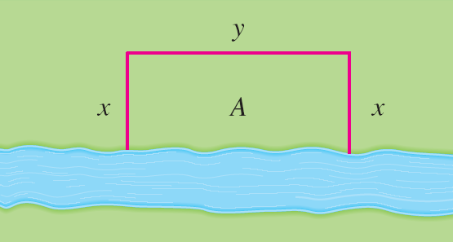
3.5. Optimization Problems
Example 3:
A farmer has 2400 ft of fencing and wants to fence off a rectangular field that borders a straight river. He needs no fence along the river. What are the dimensions of the field that has the largest area ?

Slide 44
3.5. Optimization Problems
Solution
This figure illustrates
the general case.
We wish to maximize the area A of the rectangle.
  Then, we express A in terms of x and y: A = xy
  2x + y = 2400
  So, A(x) = 2400x – 2x², 0 ≤ x ≤ 1200…….

Slide 45
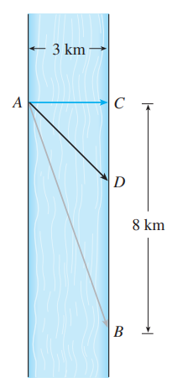
3.5. Optimization Problems
Example 4
A man launches his boat from point A on a bank of a straight river, 3 km wide, and wants to reach point B (8 km downstream on the opposite bank) as quickly as possible.
If he can row 6 km/h and run 8 km/h, where should he land to reach B as soon as possible ?
Notes:
S=vt

Slide 46
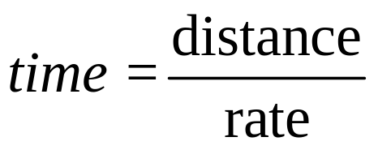
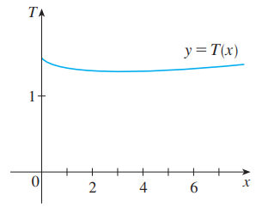
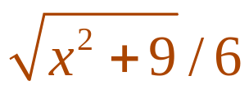
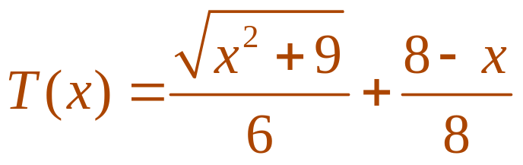
3.5. Optimization Problems
Solution
We use the equation:
  Then, the rowing time is:
  The running time is: (8 – x)/8
  So, the total time T as a function of x is:

Slide 47
3.5. Optimization Problems
Example 5:
A rectangular storage container with an open top is to have a volume of 15 m³ The length of its base is twice the width.
Material for the base costs $10 per square meter. Material for the sides costs $6 per square meter.
Find the cost of materials for the cheapest such container ?

Slide 48
3.6. Newton’s Method
Numerical rootfinders
How do those numerical root finders work?
  They use a variety of methods.
  Most, though, make some use of Newton’s method, also called the Newton-Raphson method.

Slide 49
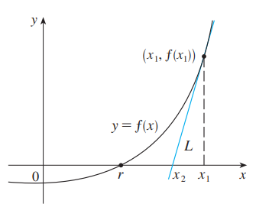
3.6. Newton’s Method
We start with a first approximation x_{1,} which is obtained by one of the following methods:
  Guessing
  A rough sketch
  of the graph of f
  A computer-
  generated graph of f
  Consider the tangent line L to the curve y = f(x) at the point (x₁, f(x₁)) and look at the x-intercept of L, labeled x₂.
Notes:
How do you do know what to choose as x₁ ?

Slide 50
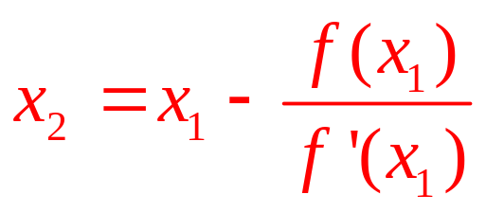
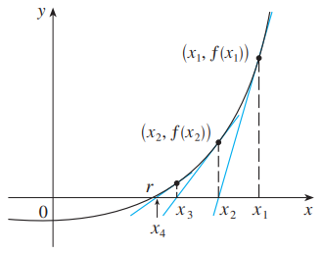
3.6. Newton’s Method
Second approximation
As the x-intercept of L is x₂, we set y = 0 and obtain:
0 - f(x₁) = f’(x₁)(x₂ - x₁)
If f’(x₁) ≠ 0, we can solve this equation for x₂:
  We use x₂ as a second
  approximation to r.

Slide 51
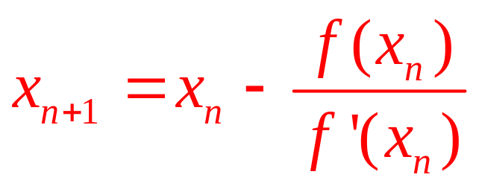
3.6. Newton’s Method
  Subsequent approximation
  In general, if the nth approximation is x_{n} and f’(x_{n}) ≠ 0, then
  the next approximation is given by:

Slide 52
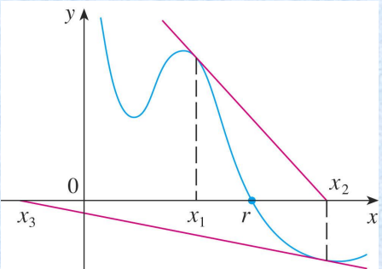
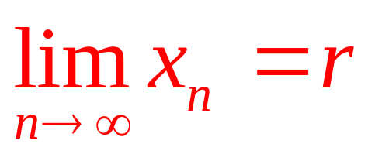
3.6. Newton’s Method
Convergence
If the numbers x_{n} become closer and closer to r as n becomes large, then we say that the sequence converges to r and we write:

Slide 53



3.6. Newton’s Method
Example 1:
Starting with find the third approximation to the root of the equation

Slide 54
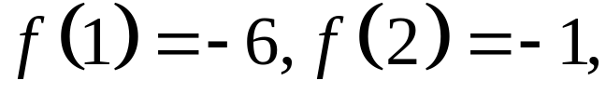
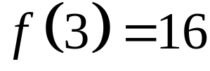
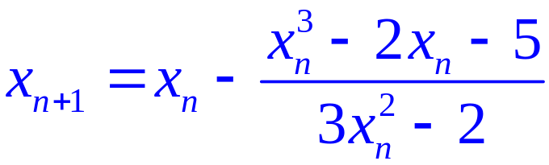

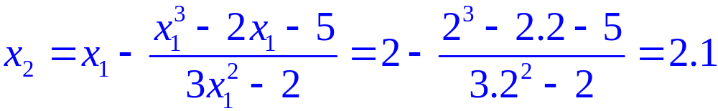
3.6. Newton’s Method
Solution:
We apply Newton’s method with
Newton himself used this equation to illustrate his method and he chose after some experimentation because and . Then
With we have

Slide 55

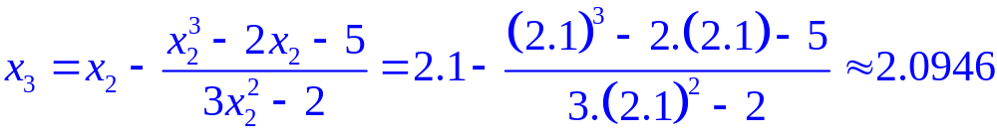

3.6. Newton’s Method
Solution:
Then with we obtain
It turns out that this third approximation
is accurate to four decimal places.

Slide 56
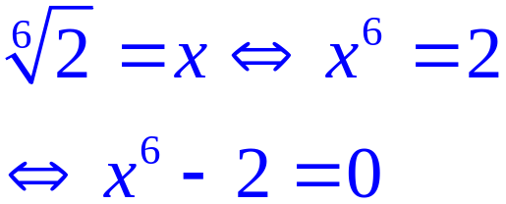
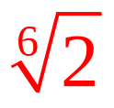
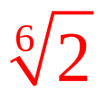
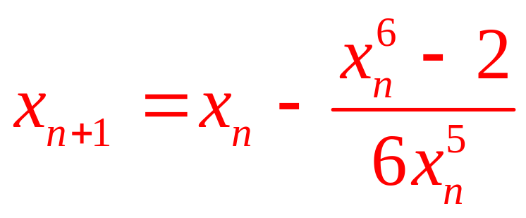
3.6. Newton’s Method
Example 2
Use Newton’s method to find correct to eight decimal places.
Solution: First, we observe that finding is equivalent to
finding the positive root of the equation x⁶ – 2 = 0
So, we take f(x) = x⁶ – 2. Then, f’(x) = 6x^{5.}
So, Formula 2 (Newton’s method) becomes:

Slide 57
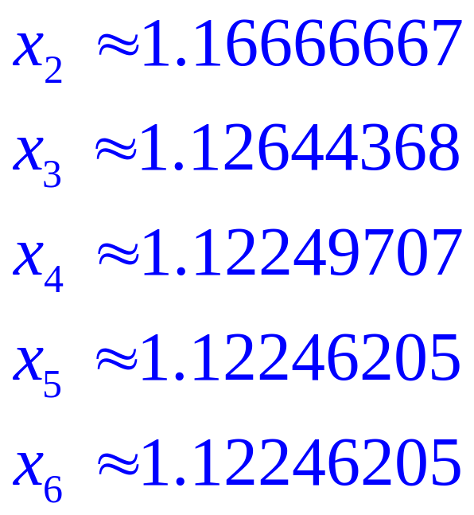
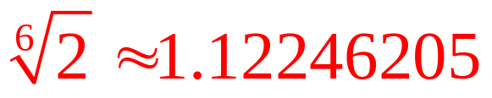
3.6. Newton’s Method
Choosing x₁ = 1 as the initial approximation, we obtain:
  As x₅ and x₆ agree to eight decimal places, we
  conclude that to eight decimal places.

Slide 58



3.6. Newton’s Method
Example 3:
Use Newton’s methed to find , the fourth approximation to the positive root of the equation
Choose your own

Slide 59
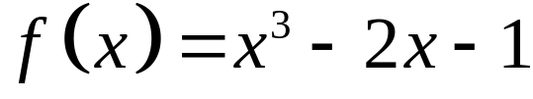


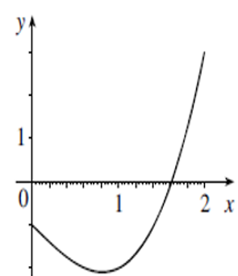

3.6. Newton’s Method
Solution:
The graph of gives as a reasonable choice .

Slide 60
3.7. Antiderivatives
Definition
A function F is called an antiderivative of f on an interval I if F’(x) = f(x) for all x in I.
Theorem
If F is an antiderivative of f on an interval I, the most general antiderivative of f on I is F(x) + C, where C is an arbitrary constant.

Slide 61















3.7. Antiderivatives
Antiderivatives formular
Here, we list some particular antiderivatives.
Function | Particular Antiderivatives | Function | Particular Antiderivatives

Slide 62








3.7. Antiderivatives
Antiderivatives formular
Here, we list some particular antiderivatives.
Function | Particular Antiderivatives | Function | Particular Antiderivatives

Slide 63



3.7. Antiderivatives
Example 1: Evaluate:
1/
2/
3/
Notes:
Answer: a

Slide 64
3.7. Antiderivatives
Rectilinear motion
Example 1:
A particle moves in a straight line and has acceleration given by a(t) = 6t + 4. Its initial velocity is v(0) = -6 cm/s and its initial displacement is s(0) = 9 cm. Find its position function s(t) ?

Slide 65


3.7. Antiderivatives
Rectilinear motion
Example 2:
A particle moves along the x-axis so that its velocity at time t is given by
Assuming it starts at the origin, where is it at
seconds ?
a. 0 b. 3/2 c. 1/2 d. - 1/2
Notes:
Answer: a

